Slide 1

‘Sustainable FoOD Choices for students’
Your name: Luke Hammond

Slide 2
Define sustainable food choices
Definition with references
“Sustainability is the practice of using natural resources responsibly today, so they are available for future generations tomorrow.”
National geographic (2022) Sustainability. Available from: https://education.nationalgeographic.org/resource/sustainability [Accessed 25 October 2022]
“Sustainable food isn’t only about the food itself. It’s a combination of factors including how the food is produced, how it’s distributed, how it’s packaged and how it’s consumed.”
Eco Beyond (2022) What does food sustainability really mean?. Available from: https://www.ecoandbeyond.co/articles/food-sustainability/ [Accessed 01 December 2022]
Combining the two responses sustainable food choices is a piece of food that factoring in produce, distribution, packaging and consumption will not limit the capabilities of people in the future.

Slide 3
Main User attitudes
List 3-4 key student attitudes that your interviews and observations revealed. Use typical sound bites from interviews/ specific behaviours observed, to characterise these different attitudes.
Finance – many students either had smaller portions, no portions or used the cheapest ingredients they could find, one participant stated, “I would say I’d go with the cheapest option, even if its not healthy as much but just cheapest”, this was quite a similar result for many other participants.
Ignorance – many of the participants were unaware of what makes a sustainable meal, the common reason for this was lack of information around now or the inconsistency of information growing up, many participants mentioned the “healthy eating plate” but when on to say it became rather irrelevant past primary school.
Unhealthy eating – there were many instances when a participant would say that the more convenient and typically unhealthy food was cheaper over the healthier food choice by a significant amount, “I went through a patch where I was lazy and eating a lot for convenience which didn’t necessarily equal healthy choices”. In addition to this, there were three participants who went through a patch of eating very little to nothing at all, “it was quite bad I would forget to eat or just not eat at all at some points”, this seemed to be a common occurrence within first year university students.
Sustainability – participants were quick to acknowledge the meaning of sustainability, and some included more specific aspects of it such as food miles and fair trade but weren’t sure how that corresponded to a sustainable food choice, “something that can last long, you can maintain it pretty well, I don’t know if that’s a good”. Many of the students seemed confused when answering or a lot of second guessing their answer

Slide 4
user needs
Based on your user attitudes, how might sustainable food choices be best communicated to students? What is the content and purpose of each bit of information?
Student need/ goal | Your ideas on how to successfully communicate (solutions/ rewards)
Recipes | Creating a database of recipes for students to use would demonstrate it is affordable as well as simple, it should encourage students to cook in a cheap and sustainable way. One participant said, “I use BBC good food most of the time, they’re also helpful because they list the nutritional value of the meal as well”. If the recipes were included on the app, it would help keep all food related needs in one place rather than scattered between websites.
Shop Prices & Budgeting | If students had access to a database of shop prices they could budget to their needs and if this was linked to the recipes, they could quickly create a shopping list (possibly incorporating a notes page into the app to keep it all in one place). A key aspect for one participant was, "Affordability, and how I'm able to get it, like how close whatever the food is to me, yeah I would consider that“. This feature would enable students to buy food cheapest and closest to them.
User Interaction, Communication & Community | “Unless you’re actively looking for it , you won't find anything about it“, this was a statement from one participant and to help find more information it is key that students have the ability to showcase their success as well as learn from one another. This could be displayed through an Instagram like feed which many of the participants stated as their favourite app.
Encouragement/Positive reinforcement | Many of the students I interviewed mentioned aspects of encouragement, they all appreciated when an app gave them a message or little features to show success – this can be seen through the likes feature on Instagram which was a very popular app between the students interviewed. One participant said, “I feel good about what I’m eating“, to keep this up a feature of the possible notes list as mentioned in Shop Prices & Budgeting is a little golden crown or golden text whenever a sustainable food choice is added to this list.

Slide 5
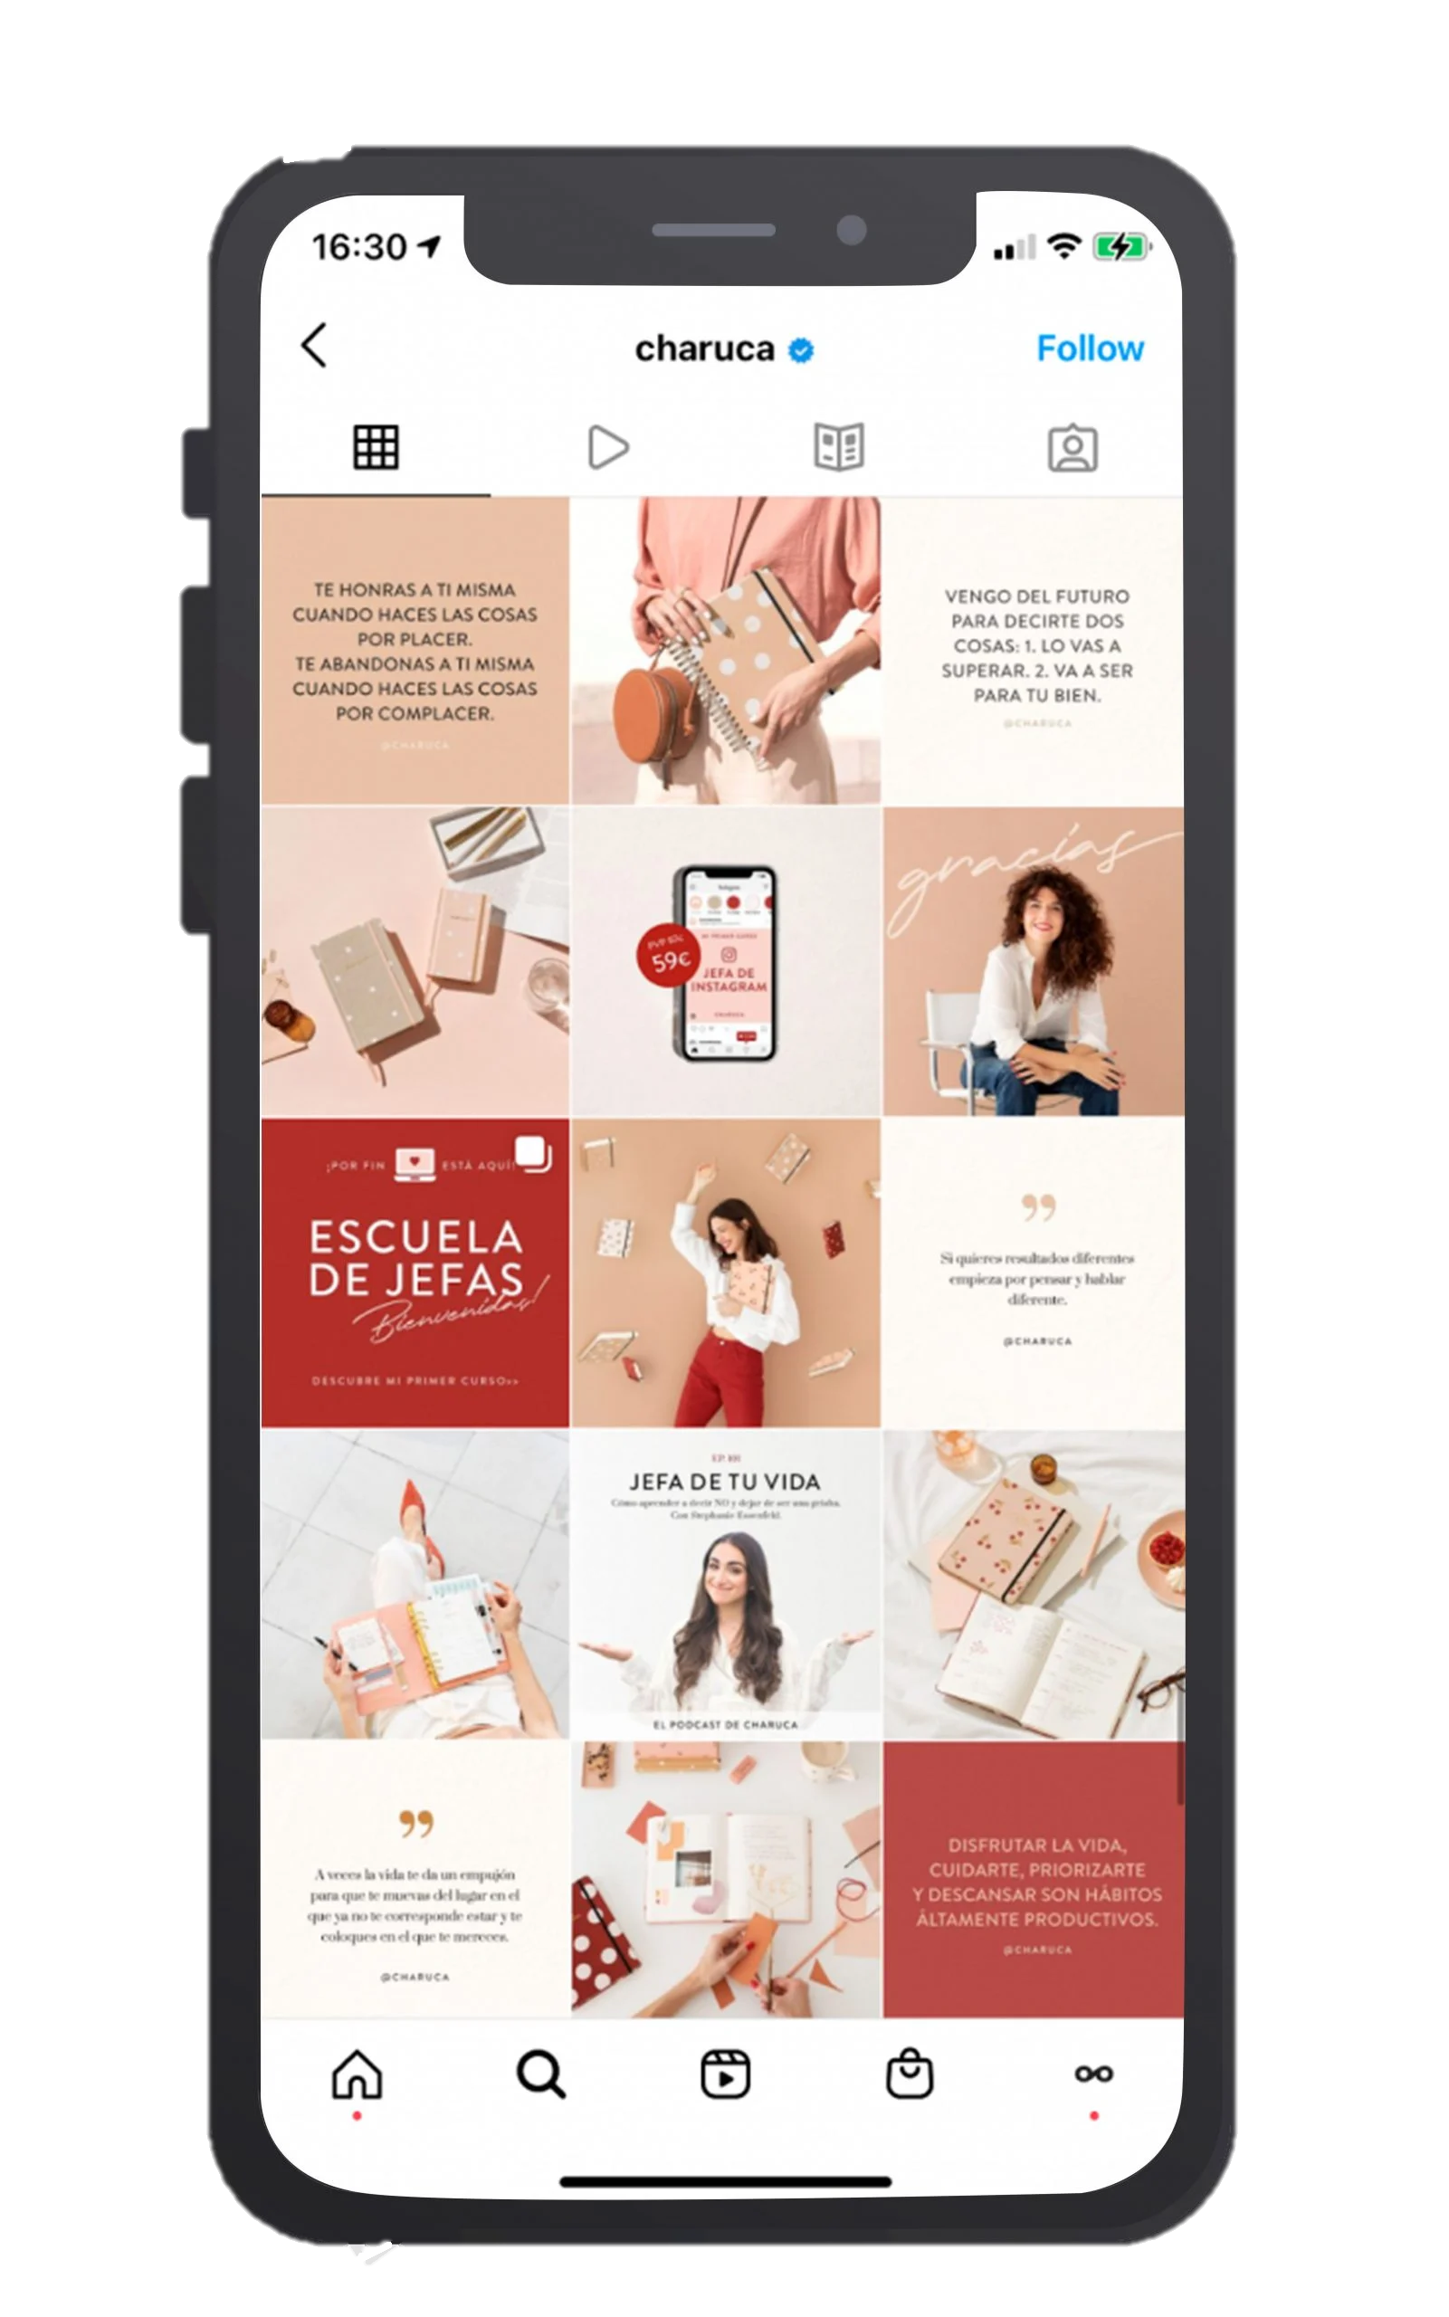
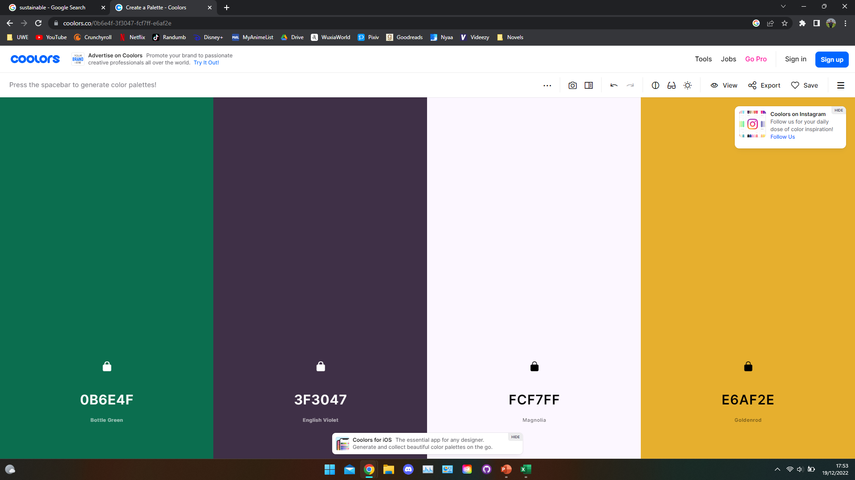



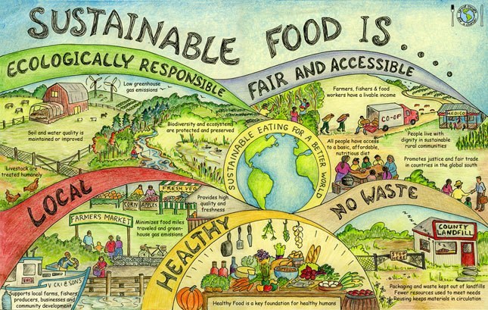

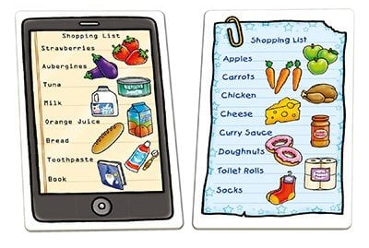
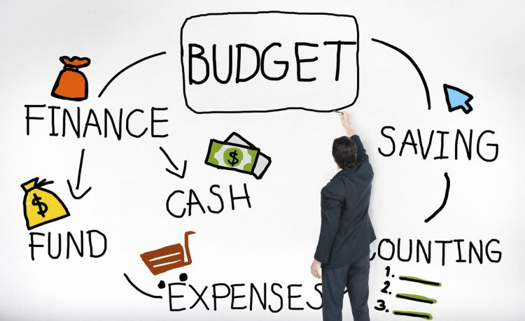
Visual Design ideas
How should this communication look & feel? This slide is for sketches, a mood board, diagrams, …

Slide 6
Pitfalls
Based on your research, what should be avoided in a ‘sustainable food choices for students’ design? What did your participants say they hated the most?
‘Bad’ Design idea | Why would this be mistake?
Barriers to using the app | You want to encourage as many people as possible, by putting limitations on certain aspects of the app you're only pushing away more users, a sign-up function can allow for more targeted content, but it shouldn’t stop people from using the app, the goal is to educate as many students as possible since many stated information was hard to come across, "unless you’re actively looking for it , you won't find anything about it… If I knew more about it, I don’t really know much about as I haven’t really been told about it, so if I got more information probably“. You don’t want this information hidden behind barriers.
Negative feedback to users | There should be no reason for a user to feel shame or confused when using the app, a user should feel enlightened, educated and more willing to learn about sustainability.
Overload of information | Information should be simple and concise; many users have been unaware about this and want a quick answer to their question to get involved, you don’t want a user to feel belittled or bad about themselves for not knowing the information sooner.
Discrimination of finance | Many students don’t have much money but not all, sustainable food should be encouraged for all, there should be an inclusion for every financial group, this can be achieved through a shop database telling users various prices of items in different shops. This can allow users to decide their most effective place for shopping rather than being pushed towards one. Many of the participants stated, if they had “infinite” money or “more money” they would welcome sustainable eating, therefore sharing the information of various shops can help students budget and improve their sustainable eating choices.

Slide 7
Main Design recommendations
What are your key recommendations when it comes to designing something around sustainable food choices for students?
Recommendation | Evidence from interview/ observation | Priority (high, mid, low)
Intuitive navigation | Instagram being one of the favourite app is built around this idea of a intuitive navigation, its easy and can keep many entertained, something as simple as a scroll or swipe can help users understand the app a lot easier. | Mid/Low
Food benefits & information | If you help people understand the meaning and importance of sustainable eating it could encourage people to do it more often, for example participant B stated, “if I knew more about it, I don’t really know much about as I haven’t really been told about it”. They’re definitely not the only person in this position and therefore it is important to educate people on the matter. | High
Photo reel/feed | Many of my participants stated Instagram to be their favourite app, this implied it was crucial to have a similar feature and the most iconic is the Instagram feed. This can be incorporated into the app as means of building a community and allow people to showcase different recipes to one another. This would help push the agenda of eating more sustainably when looking at what others are doing. | High
Fun/collaborative | One of my participants had a game as their favourite app, this could be a fun and more interesting approach to teaching/helping people to eat sustainably, small mini games to help educate people or a login bonus everyday which eventually add up to a reward of some sort. The mini games included can help educate people on different areas of sustainability such as food miles or fair trade. | Low
Praise system | Many of my participants appreciated when apps made them feel good or positive about themselves, this can be easily incorporated with achieving set goals or little messages when using the app. A main one would be the inclusion of highlighting sustainable food and when used for a meal make the user feel a sense of achievement. | High
Controlled organization | Participant F liked Spotify the most which has a very good user-controlled organization function, this could help uses navigate and favourite their most liked dishes. User organization can come in many forms from customizing the layout of the app to the inclusion of folders, its imperative that users have a say in the app as they will feel more in control and therefore earn a feeling of success when achieving a sustainable food choice. | Mid

